Slide 1
Tiaxa
FARMER CREDIT SCORING
(PRABHU)
SUMMARY OVERVIEW

Slide 2


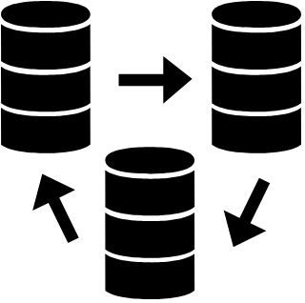







PROCESS FLOW
STEP 2: Data Mapping
STEP 3: Data Preparation
STEP 4: Creation of Masterfile
STEP 1: Data Dictionary
Method: Individually inspect elements of each columns from each data source, and locate common columns.
Method: Using database languages (i.e. SQL, PostGreSQL, etc.) to transformation of raw data into their required aggregates.
Method: Using a database language (i.e. SQL, PostGreSQL, etc.), to merge the different data sources into a single file.
Purpose: to provide meaning to each column.
Provides a picture of what is the data for, how it is used, and why it is recorded and stored.
Purpose: Provide a format that will be fed into the model. This will be the file where the model will “learn”.
Purpose: to find primary keys that will be used to merge the different datasets together.
Purpose: Simplify each data source into a manageable and useable format..
STEP 6: Model Validation
STEP 5: Model Creation
STEP 8: Pilot Run on new data sets
STEP 7: High Level Approval
Method: For each result of the iteration, the resulting output will be validated based on the parameters used (i.e. frequency of dairy sales, volume of milk, etc.)
Method: Based on the Masterfile, this will be the a series of iterations.

Slide 3



SUMMARY OVERVIEW – WALLET DATA
1
GetWalletDetails
555 unique farmers
This is the total population of unique farmers with wallet details
433 unique farmers
GetWalletTXNDetails
78% of these farmers have actually used their wallet
GetRemittanceDetails
148 unique farmers
34% of them have remittance transaction with various credit cooperatives

Slide 4

SUMMARY OVERVIEW – WALLET DATA
1
Implication
555 unique farmers
(GetWalletDetails)
Merging all three datasets will result in a very small base. This will lead to a more frequent “High Risk” since most of the farmers who do not have a GetRemmitanceDetails will be deemed as “with Incomplete Data” even if they are verified.
433 unique farmers
(GetWalletTXNDetails)
148 unique farmers
(GetWalletTXNDetails)

Slide 5

SUMMARY OVERVIEW – WALLET DATA
Proposed Solutions
1
555 unique farmers
(Please choose which of the two proposed solution is amendable to you)
(GetWalletDetails)
#1 : Use the common dataset from GetWalletDetails and GetWalletTXNDetails. This is maybe reasonable since not all farmers have a relative outside of Nepal.
433 unique farmers
(GetWalletTXNDetails)
#2 : Still use the small base population given the caveats as stated in the Implication (previous page).
148 unique farmers
(GetWalletTXNDetails)

Slide 6


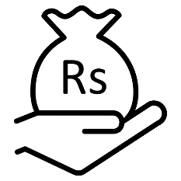
SUMMARY OVERVIEW – COOP DATA
1
466 unique farmers
GetCoopCBSDetails
Composed of verified and unverified farmers
464 unique farmers
GetAccountHistoryofSaving
99.6% of these farmers have savings account
37 unique farmers
GetAccountHistoryofLoan
8% of them also have existing loan account

Slide 7
SUMMARY OVERVIEW – COOP DATA
1
Implication
Merging the three dataset resulted in even fewer base.
37 unique farmers
(GetAccountHistoryofLoan)

Slide 8
SUMMARY OVERVIEW – COOP DATA
Proposed Solution
1
(We need you to answer if you agree to the proposed solution)
464 unique farmers
Instead of creating a single Masterfile, use this set of data (farmers with savings account), since there are only a few farmers who availed of a loan.
This is also reasonable as not everyone may need a loan, many farmers are more focused on savings.
(GetAccountHistoryofSaving)

Slide 9
SUMMARY OVERVIEW – FARMING DATA
GetDairyActivities cannot be merged with the GetAgroActivities due to difference in ID Number
21 unique farmers
96 unique farmers
(GetAgroActivities)
(GetDairyActivities)

Slide 10
SUMMARY OVERVIEW – FARMING DATA
Implication
No Masterfile can be created by merging this two datasets.
21 unique farmers
96 unique farmers
(GetAgroActivities)
(GetDairyActivities)

Slide 11
SUMMARY OVERVIEW – FARMING DATA
Proposed Solution
(We need you to answer if you agree to the proposed solution)
Due to a small base in these dataset it is preferable that we will not use this as of the moment.
We recommend that all activities be digitized.
21 unique farmers
96 unique farmers
(GetAgroActivities)
(GetDairyActivities)

Slide 12
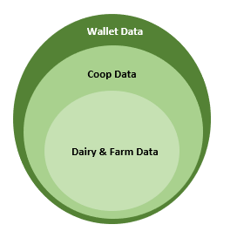



PROPOSED SCORING SYSTEM
As of the moment, no relationships exist in the sample data source that was provided. Merging all three data sources resulted in a null database.
To address this problem, we recommend a scoring system with a goal to encourage farmers encouraging them to use the wallet more frequently, and at the same time, be more financially literate and responsible. Note that this scheme is limited to dairy farmers only. The scheme is based on the following assumptions:
Not all people who have wallet data are dairy farmers.
Not all people with cooperative data are dairy farmers.
Not all farmers will have remittance dataset.
Due to the limited number of farmers who used in the loan history.

Slide 13

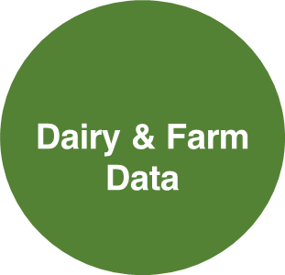


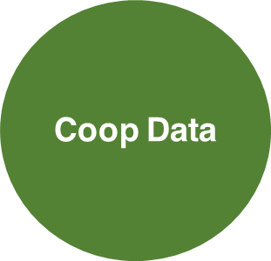
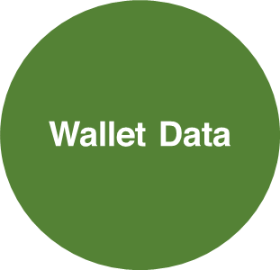

PROPOSED SCORING SYSTEM
The scheme is based on incentivization and is as follows:
1. If the farmer only has one set of dairy data, a score will still be provided but this will be of the smallest amount.
2. If the farmer has both dairy data and cooperative data, then a score will be provided allowing the farmer to avail of a higher amount.
3. If the farmer has all three data points, a score will be provided allowing the farmer to avail of the highest loanable amount.
=
=
=

Slide 14
APPENDIX

Slide 15

SUMMARY OVERVIEW – WALLET, COOP & AGRO
555 unique farmers
GetWalletDetails
This is the total population of unique farmers with wallet details
GetCoopCBSDetails
4 unique farmers
0.7% of these farmers have information in Coop CBS
1 unique farmer
GetAgroActivities
Only 1 of them have agro activities recorded

